Slide 1

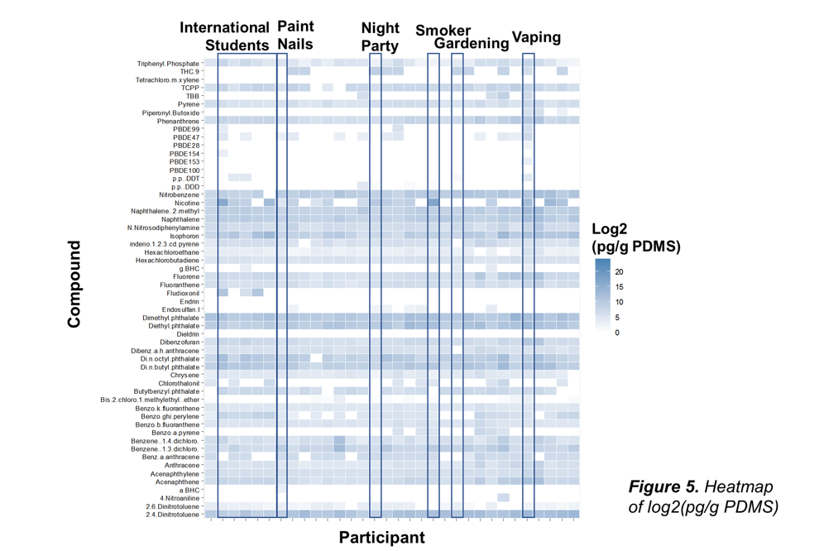
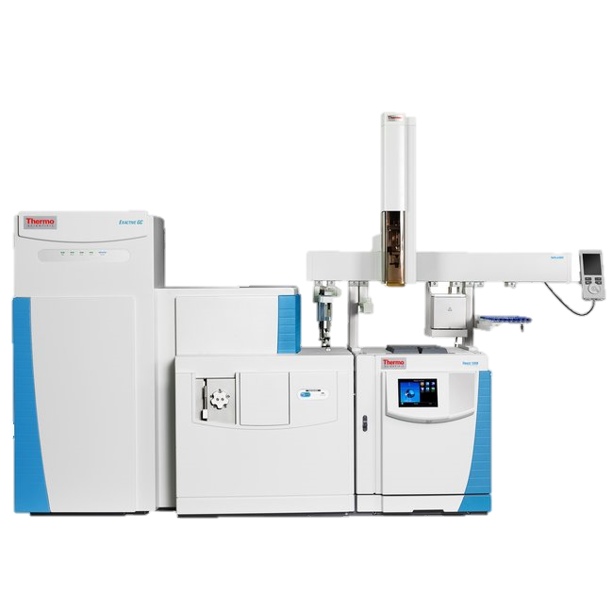
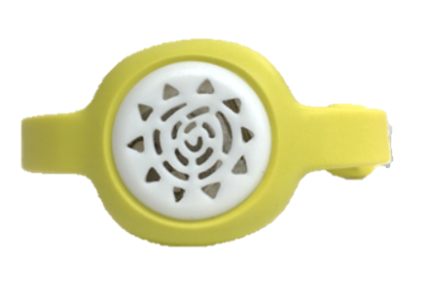
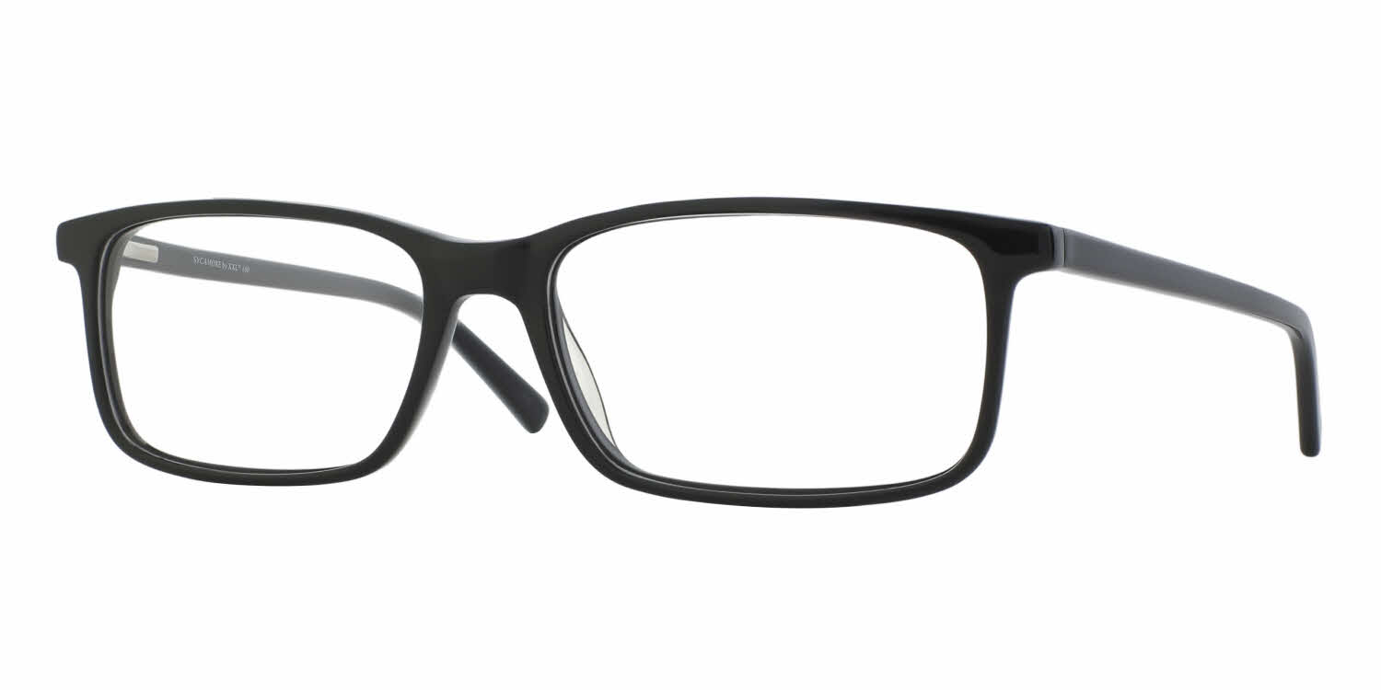

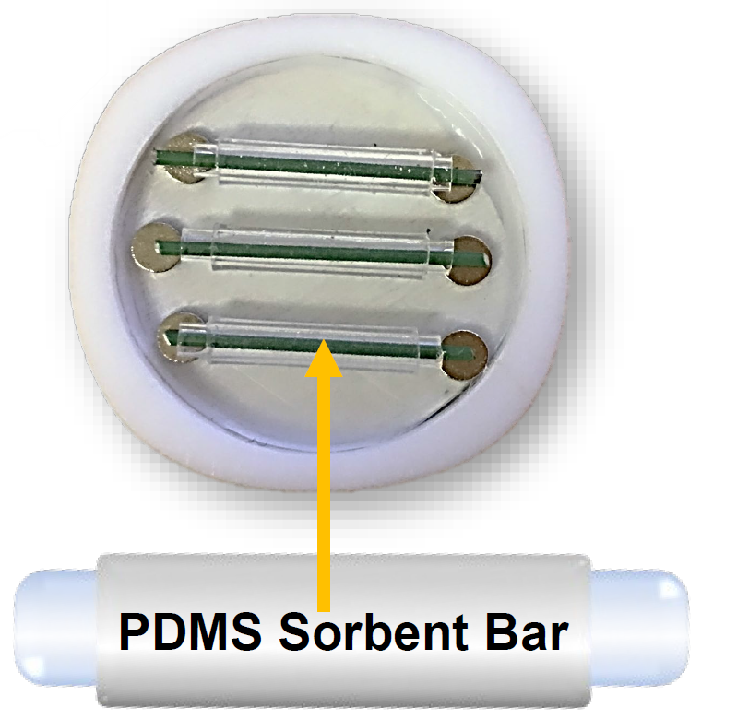
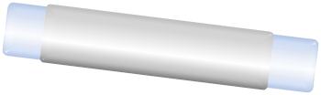
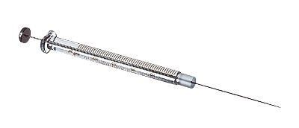
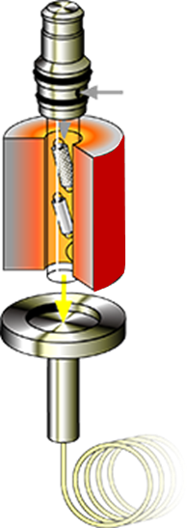
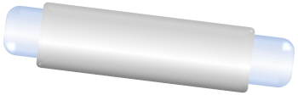
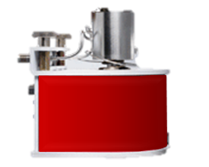
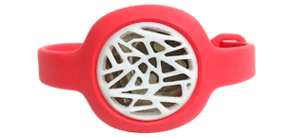

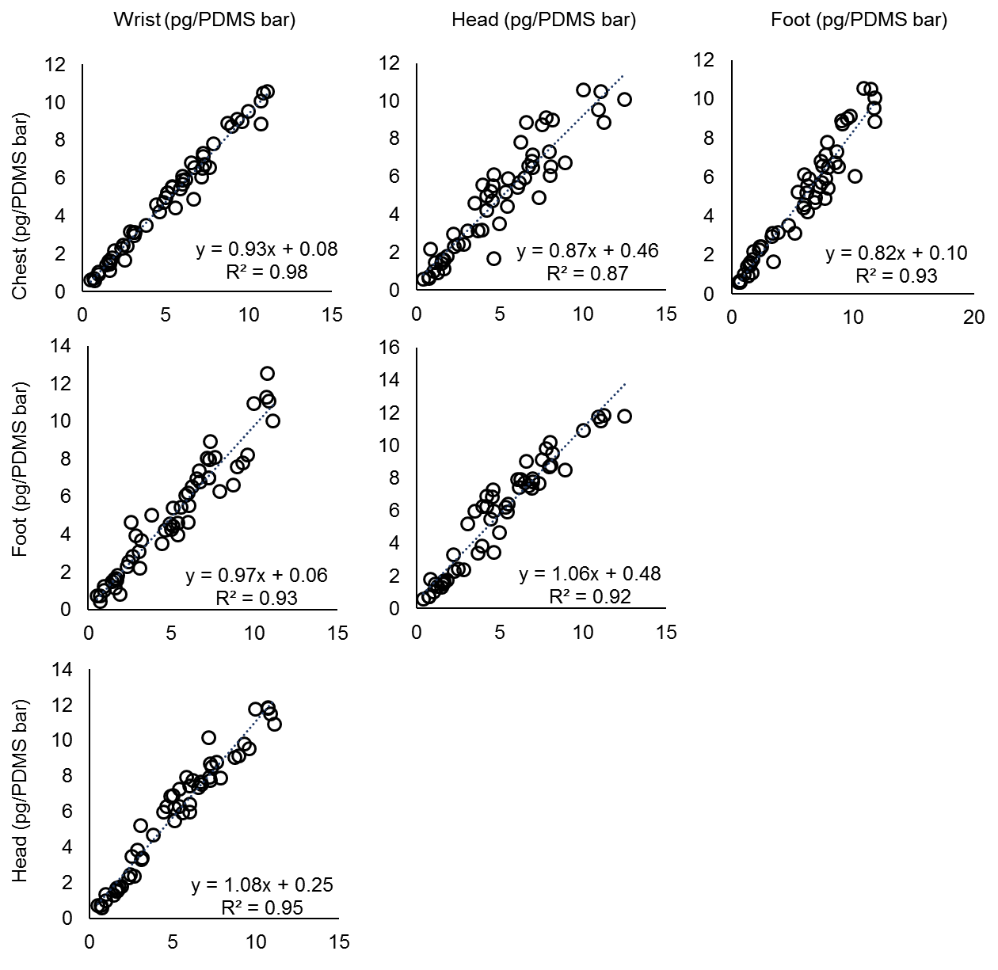
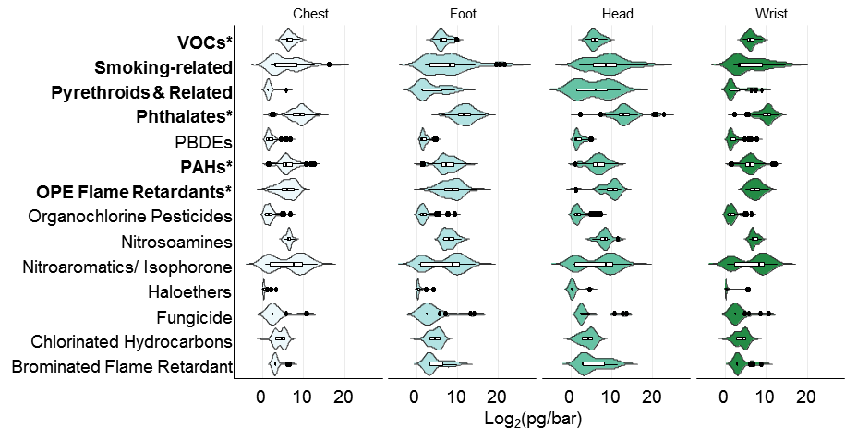

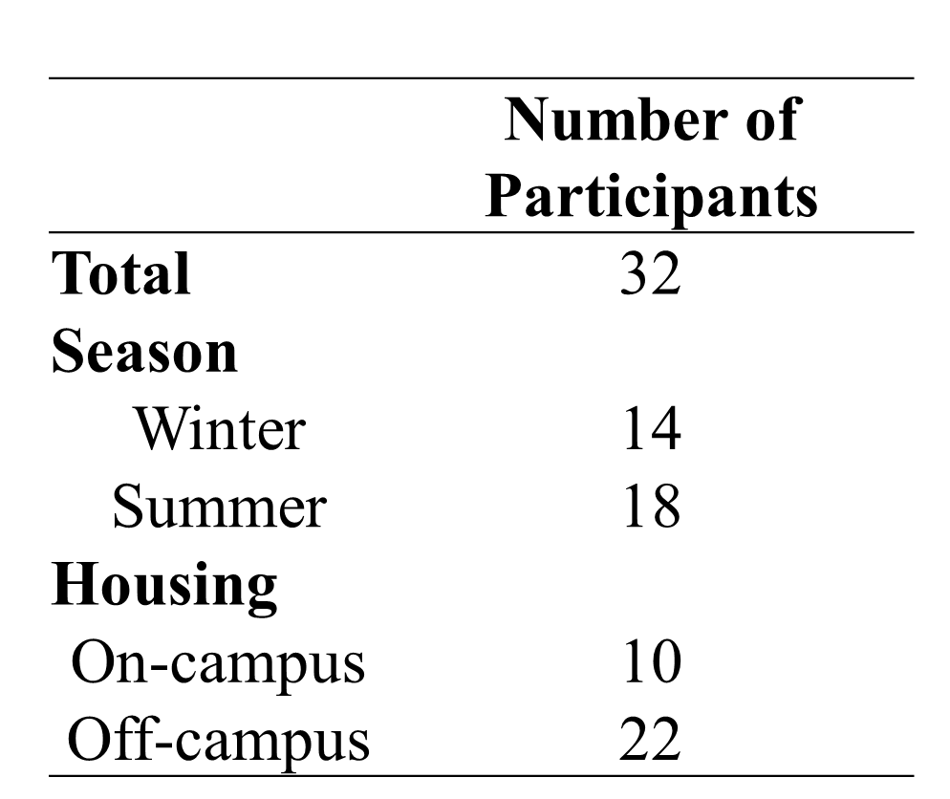
Title
The Fresh Air Wristband: targeted analysis of personal exposure to airborne semi-volatile organic compounds in a Chinese cohort
Elizabeth Z. Lin¹, Jieqiong Zhou ^{1,2}, Jeremy P. Kolmel¹, Song Tang², Krystal J. Godri Pollitt¹
¹ School of Public Health, Yale University ² Gradient ³ National Institute of Environmental Health, ChinaCDC
Characterizing the External Exposome Using Passive Samplers – Comparative Assessment of Chemical Exposures Using Different Wearable Form Factors
Elizabeth Z. Lin¹, Amy Nichols², Yakun Zhou¹, Jeremy P. Koelmel¹, Krystal J. Godri Pollitt¹
¹ School of Public Health, Yale University ² Chemical & Environmental Engineering, Yale College
School of Public Health
Introduction
Objective
Results
Characterizing cumulative exposure to air pollutant mixtures is a critical step in understanding disease development. Overcoming this research challenge requires the creation of new technologies for capturing and analyzing exposures.
Different indoor activity patterns can lead to unique exposure mixtures across individuals. Characterizing personal exposure to indoor air pollutant mixtures is a critical step in understanding indoor risk factors for disease.
Current personal air pollutant monitoring systems are cumbersome. Pollutants sampled onto foams or filters are typically solvent extracted and analyzed by GC-MS. This sample preparation approach is time-intensive and limits the feasibility of evaluating personal exposure on a larger scale.
The size, weight and cost of these air sampling systems further prevents use with vulnerable populations (i.e. seniors, pregnant women, infants). There has been limited development of techniques to capture the cumulative exposure of individuals at critical windows of susceptibility to air pollutant mixtures.
Passive Air Pollutant sampling
We developed a wearable air pollutant sampler in the form of wristband or clip which can be worn during most indoor activities without impeding mobility (Figure 1A). The samplers contain a PTFE chamber which houses 3 to 5 sorbent bars (Figure 1B). These bars use polydimethylsiloxane (PDMS) passively concentrate non-polar compounds from the air via absorption.
Contrast personal environmental contaminant exposure measured using personal samplers worn in different position on the body.
Personalized exposure profiles were identified and varied by individuals’ behaviors. The time-weighted average exposure cannot be explained by the single activity (Figure 5).
There were differences in measurements from samplers placed at different body locations. Differences were found in the estimated exposure for any two sampler locations (Figure 6A). There were 23 chemicals showing that levels near the head was the highest, the concentration for 19 chemicals was the highest near the foot.
Seasonal variation was found. There were 32 analytes with significant seasonal difference, 28 chemicals showed higher levels in summer, 4 compounds showed higher levels in winter (Figure 6B).
The exposure from two housing conditions is more significantly different during winter than summer. It is indicating the source of exposure is different between on- and off-campus participants, this difference is magnified during winter (Figure 6B).
Methods
PDMS sorbent bars were cleaned by heating to 300 ºC under a flow of a high purity N₂ for 2 hours.
The FreshAir samplers were worn by individuals for 24 hrs, each sampler contained four sorbent bars. Follow the exposure assessment period, each sorbent bar was removed from the sampler and stored in a 2 mL amber vial at 4 ºC.
Sorbent bar samples were analyzed offline using a gas chromatograph high-resolution mass spectrometer, the TD (Gerstel)-HRGC (Thermo Orbitrap). The sorbent bars was heated to 250 ºC under a flow of He. Extracted compounds were cold trapped in spitless mode onto a glass wool liner cooled to -90 ºC prior to elution onto the GC. Analytes were separated with TraceGOLD TG-5SilMS GC column (30m/0.25mm). The mass spectrometer was operated in full span electron ionization mode (70 eV). Exposure concentrations were quantified using retention times and identifying ions.
Data analysis: Multi-component deuterated standards are spiked onto samples prior to thermal desorption and monitored to account for transfer efficiency and matrix effects. Instrument data is extracted and processed using Tracefinder (Thermo) for 81 analytes including VOCs, PAHs, phthalates, PCBs, PDBEs, and pesticides. Statistical analysis was conducted using R Studio 3.6.1.
1. Personal exposure (24 hours).
2. Load bar with known amounts of deuterated standards.
3. Thermal desorption of pollutants from the bar.
4. Separation
and detection of pollutants
using gas chromatography mass spectrometry.
5. Data analysis of 81 targeted compounds.
Log₂ (pg/bar)
A.
B.
Exposure signature.
Sorbent bar.
Oven
Figure 5. Exposure profile in Log₂ (pg/ PDMS Bar)
FreshAir Wristband
FreshAir Clip
Figure 1. A) The FreshAir wristband and clip are used to passively sample airborne organic pollutants for personal and stationary exposure assessment. B) Non-polar pollutants are collected on a PDMS sorbent bar housed in a Teflon chamber mounted in a wristband or clip.
Thermo Q Exactive GC
Figure 3. Airborne pollutant exposure assessment using PDMS sorbent bars.
Study Design
Results
A.
B.
Summer
4.5e-03
Winter
Significant differences were found in four sampler placements for six chemical classes (Kruskal-Wallis test p-value<0.05, Figure 4A). This suggests samplers at each placement position might capture chemicals from different exposure sources.
Measurements from different sampler placements were positively correlated with each other. Strongest correlation was found between wrist and chest measurements, R²=0.98. (Figure 4B).
4.8e-08
4.6e-06
0.10
1.0e-03
This study was conducted in New Haven, Connecticut between August 2019 and February 2020. Participants (N=32) were members of the Yale community and aged 18 years or older. Participant each wore four FreshAir samplers over a 24 hour period (Figure 2). Samplers were placed on the wrist, near the chest, attached to eye glass frames, and on their shoe. The total exposure period was 24 hours. Each participant recording their detailed activities during the sampling and one for reporting the house characteristics (Table 1).
30
4.1e-05
8.3e-04
30
20
Log2 (pg/ PDMS Bar)
20
A.
B.
Log2(pg/PDMS Bar)
Log2(concentration)
10
10
0
0
A.
Head
Table 1. Study population characteristics
Wrist
Chest
Foot
Head
Off
campus
On
campus
Off
campus
On
campus
Chest
Figure 6. A) Violin plot by different sampler type. B) Violin plot by season and by living status
Wrist
Conclusions
Season and personal behaviors are related to the variations of different SVOCs.
While SVOCs concentrations measured by wearable samplers positioned on the head, chest, wrist, and foot were different, levels were correlated across sampler location.
Future work will evaluate relationships between analytes for individual sampler location using both targeted and suspect screening analysis.
Foot
elizabeth.lin@yale.edu
Figure 2. Selected body locations for sampling.
Figure 4. A) Summary of measurements from all wearable forms. Bolded chemical class has a significance level less than 0.05. * indicates α < 0.0001.
B) Correlation of average concentrations across compounds between different sampler placements.

