Slide 1
Becoming Breastfeeding Friendly (BBF)
Brief Development Guidance
Part IV. Branding & Design
Notes:
[Policy Brief Design + Layout]
For this presentation, I will present on branding and design for BBF briefs

Slide 2
Objectives
How to Construct Documents
Review BBF Branding
Usage of Infographics, Photographs, and Icons
Formatting “Do’s” and “Don’ts”
Additional Design Tips & Tricks

Slide 3
Steps for Design + Layout
2. Plan
4.Finalize
3. Add
1. How
Notes:
After you have drafted the content for your one-pager, infograph, and/or policy brief, you’ll be ready to start working on the design and layout
[1] First step will be deciding how you will put your brief together
[2] Plan the layout and where your content will go, including your text and figures
[3] Add content
[4] Finalize formatting
Along the way, I will offer some tips to help you put together your policy brief and hopefully save you time.

Slide 4
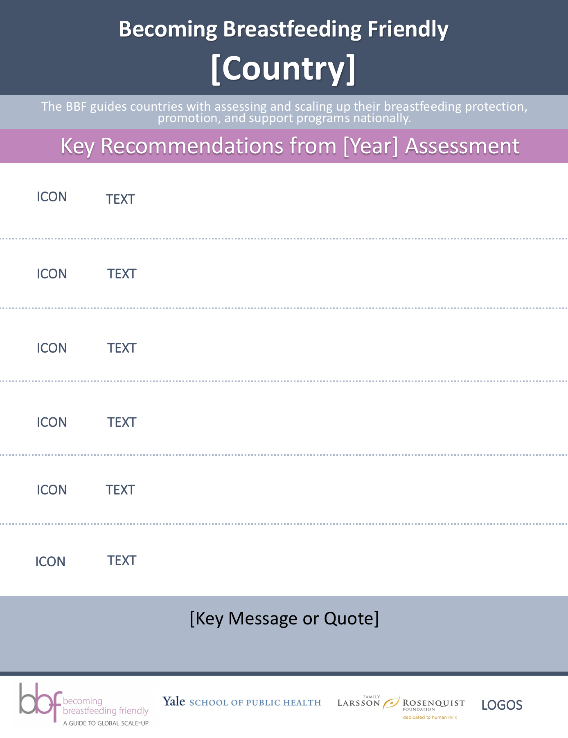
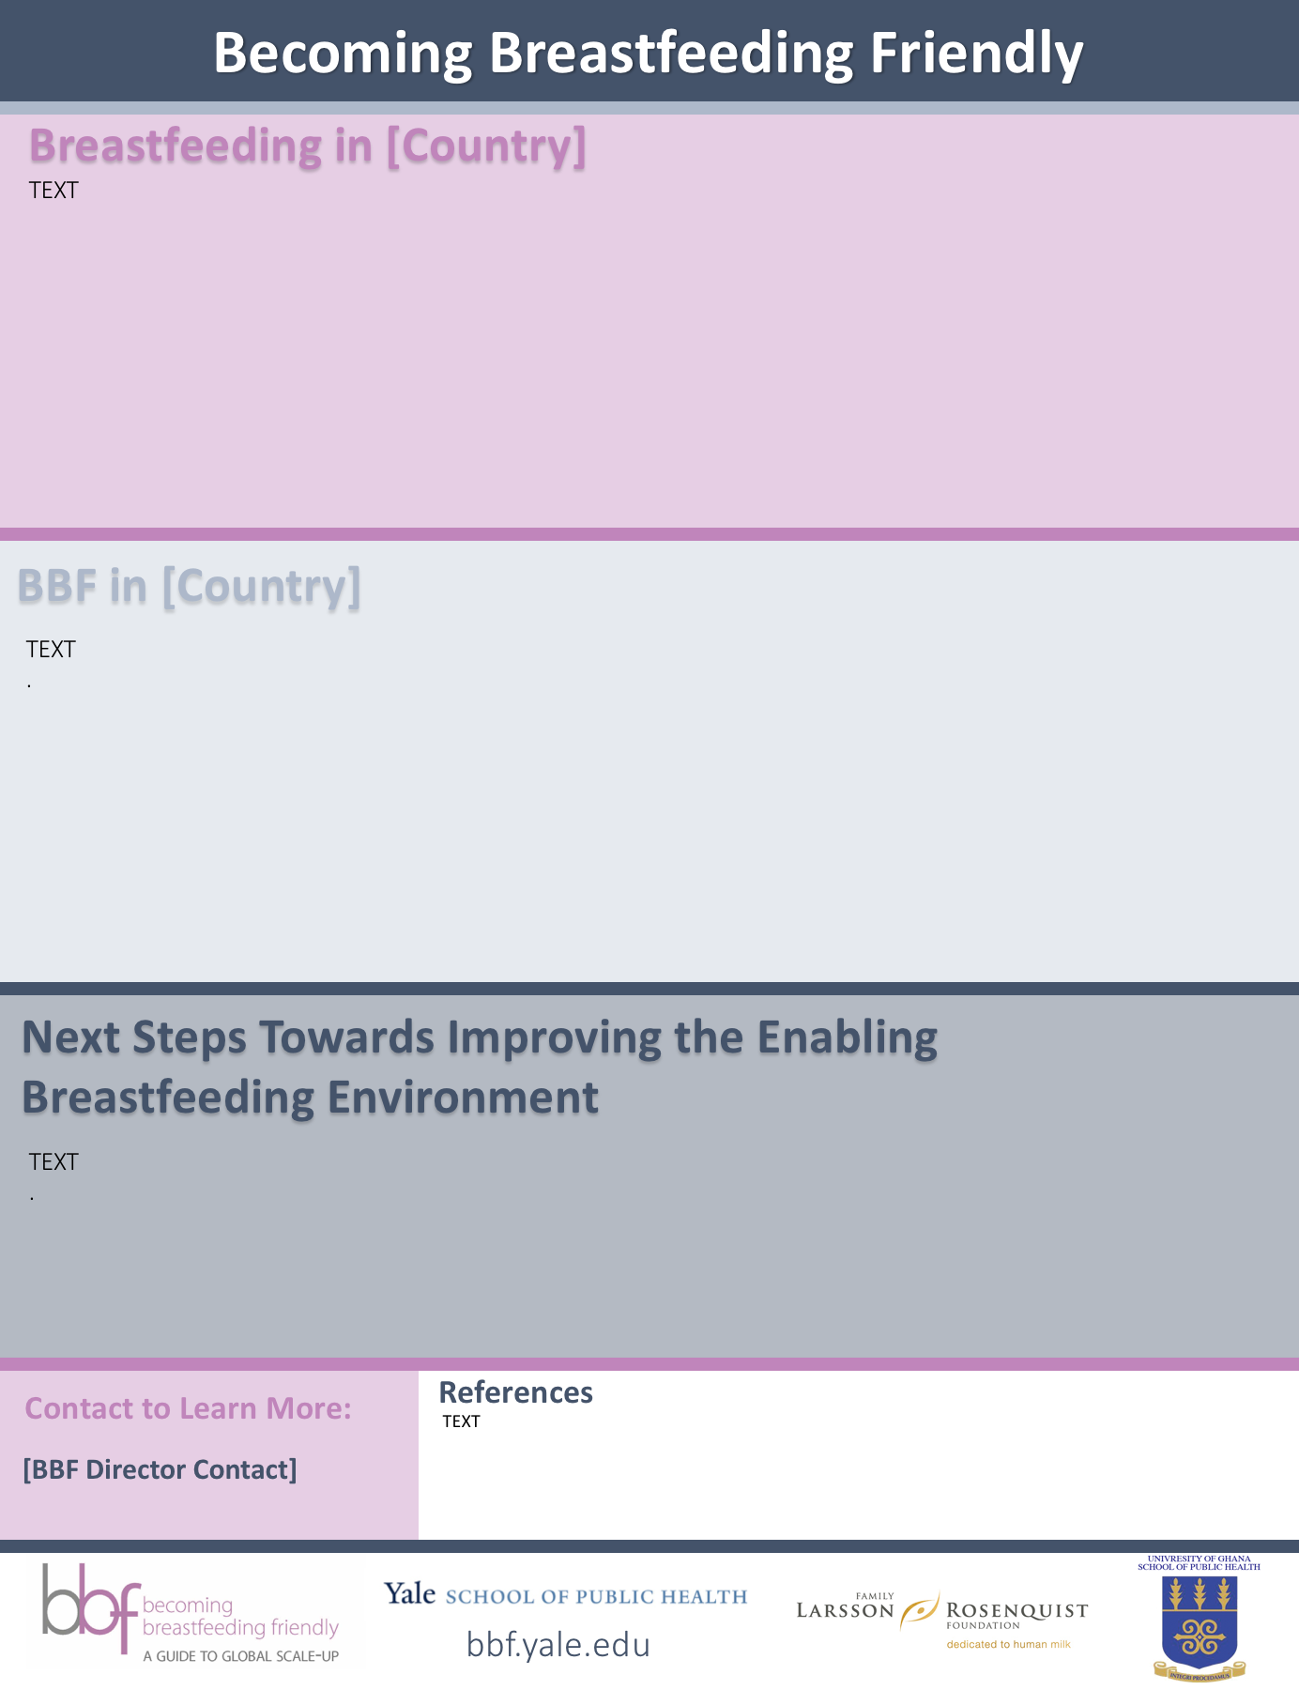
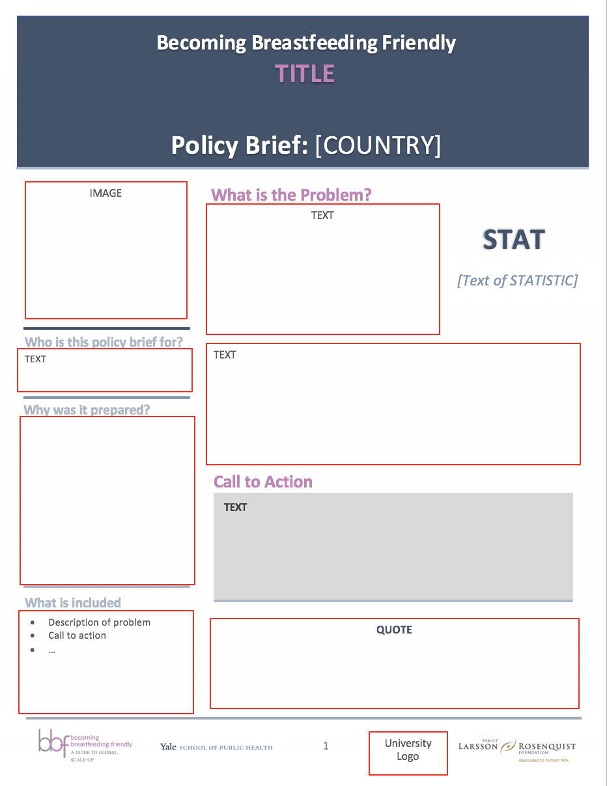
How: Design Templates & Platforms
Adobe InDesign
PiktoChart
BBF Templates
(PowerPoint)
Notes:
We have a created templates on Powerpoint
You can and should adjust layout as needed to accommodate the content going into your 1-pager, infograph, or policy brief
You can also create any of these briefs on other design software such as Adobe InDesign, which is desktop publishing software application
You can also use an online tool, such as PiktoChart (a free, easy to use online tool).
What is nice about using an online platform, such as PiktoChart, is you can create an account for your team and will be stored online for your team to easily access

Slide 5
Objectives
How to Construct Documents
Review BBF Branding
Usage of Infographics, Photographs, and Icons
Formatting “Do’s” and “Don’ts”
Additional Design Tips & Tricks

Slide 6
BBF Branding
BBF Colors | Color | RBG Color Number | Hex Color Number
 | Dark Blue | R068 G083 B106 | #44536a
 | Light Blue | R173 G184 B202 | #ADB8CA
 | Medium Blue | R131 G151 B176 | #8397b0
 | Purple | R191 G132 B185 | #bf84b9
Font | Calibri or Calibri Light
Font Size | Greater than 12
Citations | Vancouver, superscript in text
Notes:
We have put together a guide and branding document to help you create your BBF briefs
The guide includes all the branding information you see here, such as the color id numbers, and recommended fonts, font size, and citation style

Slide 7
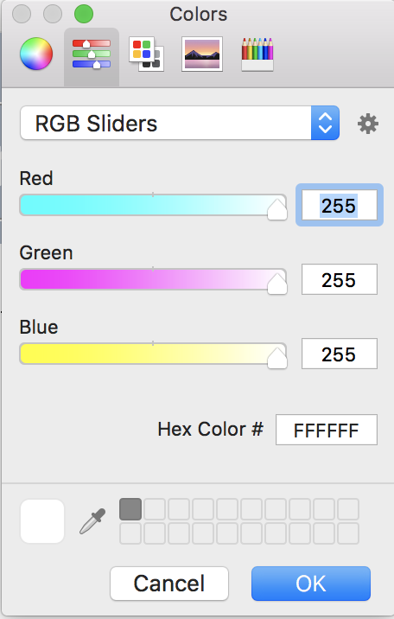
Entering Color Numbers
1. More Colors
2a. Enter Color Numbers
RGB Color Numbers
Hex Color Numbers
2b. Use ‘Ink Dropper’
Notes:
To enter the BBF colors:
Go to more colors anywhere you want to change the color, for example, the colors of your text
You can then enter the Red, gred, blue colors numbers
OR the Hex color number (we provide both options in the branding table because some software programs, such as PiktoChart only ID colors using Hex Color Numbers)
On any Microsoft or adobe application, you also have the option to use what is call and ink dropper. When you click and hold the ink dropper, you can move it anywhere on you screen to ID a color

Slide 8
Objectives
How to Construct Documents
Review BBF Branding
Usage of Infographics, Photographs, and Icons
Formatting “Do’s” and “Don’ts”
Additional Design Tips & Tricks

Slide 9
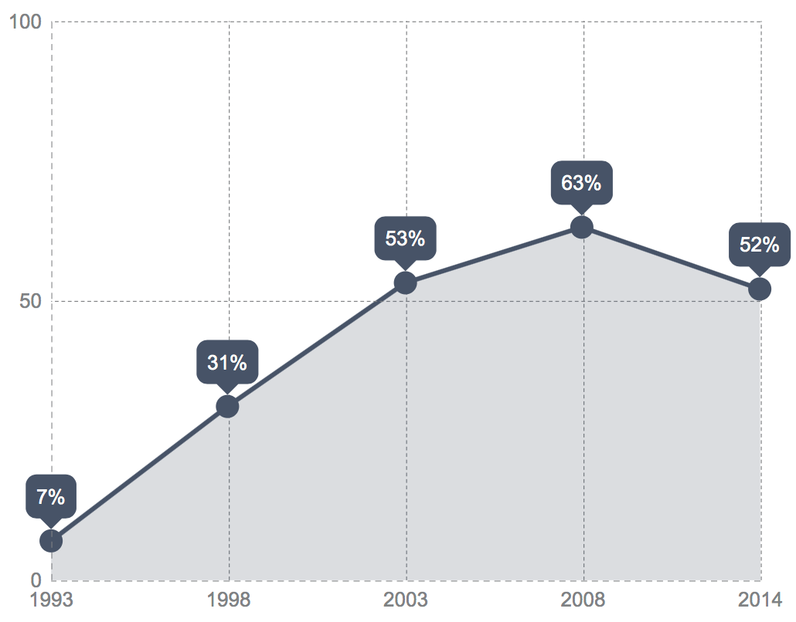
What is an infographic?
BBF Infograph | Infographic
One page document to disseminate policy recommendations to general population in given country. | “Information Graphic” (images, charts, graphs) to communicate a clear message and that simplify information for a general audience.
Exclusive Breastfeeding in Ghana
Percent (%)
Year
Notes:
“Infographic,” not to be confused with a one page inforgraph, is an abbreviation for ”information graphic” and uses visual cues to communicate information

Slide 10
The 7 Graphic Design Principles of Infographic Design
Get to Know Your Audience
Restrict Color
Align Elements
Prioritize Parts of Infographic
Highlight the Heading
Invest in Imagery (wisely)
Choose Charts Carefully
Stones & Gent (2015) Visualising Health: Infographics in Public Health. University of Leeds. Available from: https://visualisinghealth.files.wordpress.com/2014/12/guidelines.pdf
Notes:
Infographics can be used in any of your briefs to communicate information.
I have provided a resource that has studied the usage of infographics in public health.
To provide a brief overview
Get to Know Your Audience-
1) Who is your audience? 2) What is the key message you want them to ‘take away’?
3) What are the key barriers to communication?
* The some of the BBF briefs are for non-health audiences, which will be important to consider when developing the content of your briefs
Restrict Color- generally try to stick to 3-5 colors
Align Elements- use gridlines and be consistent with your alignment
Prioritize Parts of Infographic- for figures, make sure there is a focal point and pick our key statistics with larger font
Highlight the Heading- these graphics need to have heading to guide readers, for more persuasive infographics- use to highlight why your key messages are important while also considering appropriate positive and neutral framing.
Invest in Imagery (wisely)- images and icons can be used to re-enforce the message, to alert the reader to the topic the image it depicts and to make the infographic more visually interesting.
Choose Charts Carefully- If using charts to display statistical information, keep the charts simple and label them. Will also want to provide an interpretations of your chart.

Slide 11
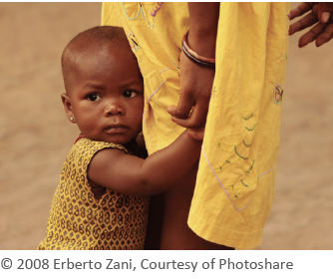
Photos & Icons
Photos
Use your photos!
Photoshare
Icons
BBF Branding & Design Guide
PiktoChart
Tip: When changing the size of your image, press and hold shift to keep original proportions
Notes:
In addition to infographics, you can use photos and icons to help communicate your messages in your briefs,
You can use your own photos or request to use photos from collections such as Photoshare (USAID and Johns Hopkins)
Icons can be found online or in the branding and design guide that will be made available to you
Or you can use Piktochart, the online software program I mentioned before, also has additional icons

Slide 12
Copyright & Intellectual Property
When in doubt, assume a photo that is not your own is subject to copyright and don’t use it without the appropriate permission.
Read more here: https://www.socialmediaexaminer.com/copyright-fair-use-and-how-it-works-for-online-images/
Notes:
When developing your briefs, if you’re using any photographs that is not your own, you need to have appropriate permission to use these images
Photo permissions can vary by country
I recommend looking into your country’s copyright and intellectual property laws before using others photographs to avoid any penalties (which can be up to $25,000 per penalty in the US)
In the Unites States, Copyright is a federal law that protects original works of authorship. A work of authorship includes literary, written, dramatic, artistic, musical and certain other types of works.
When in doubt, assume it’s subject to copyright and don’t use it without the appropriate permission.
Copyright faire use: Fair use is a legal exception to the exclusive rights an owner has for his or her copyrighted work.
Fair use is not the same as free use.
The purpose of the Fair Use Doctrine is to allow for limited and reasonable uses as long as the use does not interfere with owners’ rights or impede their right to do with the work as they wish.

Slide 13
Objectives
How to Construct Documents
Review BBF Branding
Usage of Infographics, Photographs, and Icons
Formatting “Do’s” and “Don’ts”
Additional Design Tips & Tricks
Notes:
I will now provided some guidance on formatting do’s and don’t when putting together and finalizing your briefs

Slide 14
Editing Images in PowerPoint
Remove Background
Go to “Picture Format”
Go to “Remove Background”
Change Color of Icons
Go to “Picture format”
Go to “Color”
*Tip: Remove background before changing color, even if white
Notes:
*Demonstrate in Recording*

Slide 15
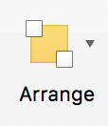
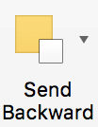
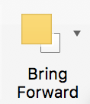
Arrange
Send Backward
Send Forward
Tip: Use “Arrange” to move images/text boxes backwards or forwards (“Home” or “Shape Format”).

Slide 16
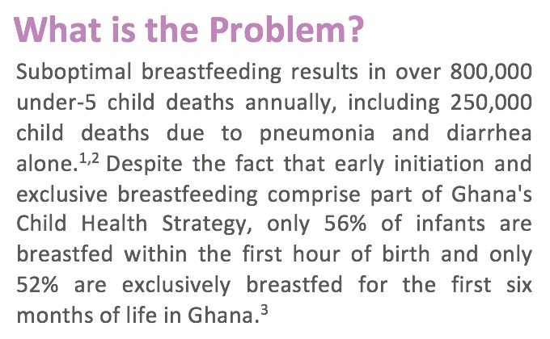
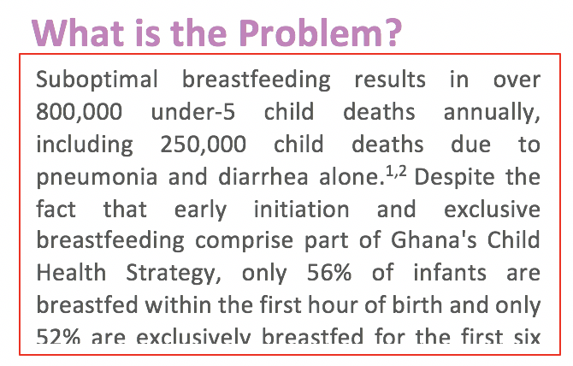
Finalizing Briefs
1. Remove Text Box Lines
2. “Justify Text” Alignment
Notes:
1. Remove text box lines, when you do make sure all you text is visible and not cut off
2. Justify text alignment for a “clean” look

Slide 17
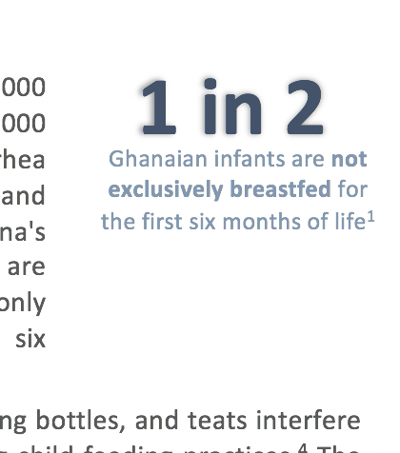
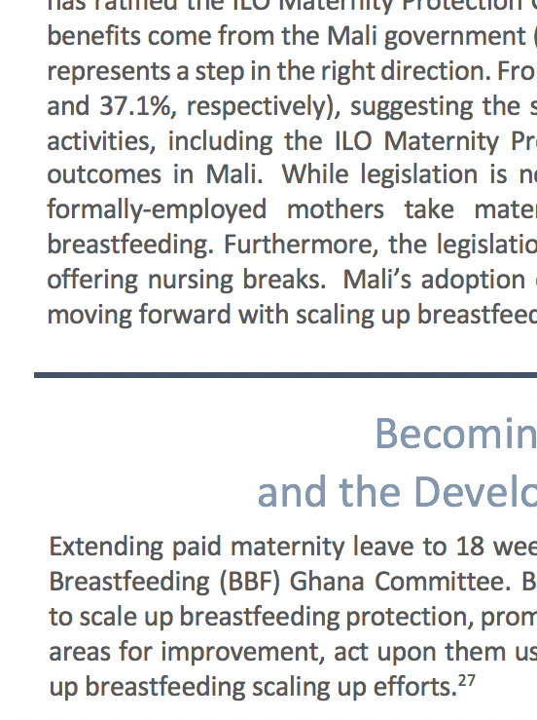
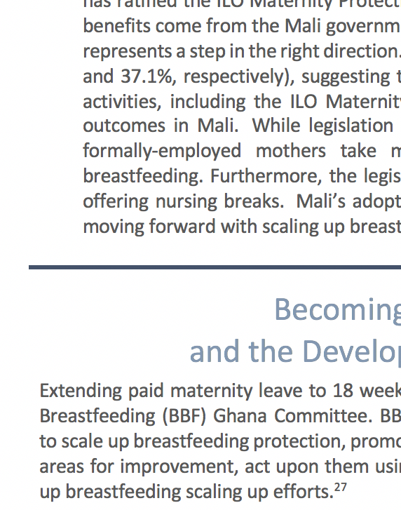
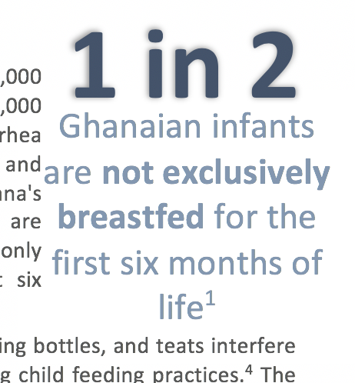
Finalizing Briefs
3. Check Alignment
4. Check White Space
Tip: Press shift or command to select and move multiple items at once.
Notes:
Tip: Depending on the program and type of computer you’re using your on, you can Press shift or command to select and move multiple items at once. [SHOW]

Slide 18
Finalizing Policy Brief
Proof Read
Text
Format
Check Margins
PDF
Print
Notes:
To finalize your Briefs:
Proof read, not just the text for spelling and grammatical errors, but formatting as well for items such as alignment errors.
Check the margins after you convert your policy brief to a PDF and print a copy to make sure nothing was cut off

