Slide 1
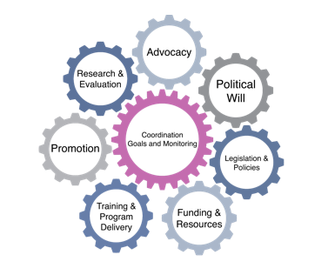
Becoming Breastfeeding Friendly (BBF)
Policy Recommendation Development
Priority Recommendation and Development of Key Actions
[BBF Country Name, Director Name, Committee Members’ Names]
1
Notes:
[Instructions for BBF Country Director/Coordinator: Fill out Country Name, Director/Coordinator Name, and Committee Members’ Names]

Slide 2
Recommendation Grading
Recommendation | Effectiveness Score | Affordability Score | Feasibility Score | Recommendation Score
1
2
3
4
5
6
7
8
9
10
2
Notes:
[Instructions for BBF Country Director/Coordinator: Remind audience of agenda for meeting 4 and illustrate example of priority recommendation: the Code]

Slide 3
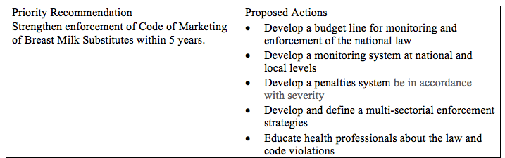
Priority Recommendations & Proposed Actions: Example
During meeting 4:
Include the priority recommendations that emerged from the prioritization process and develop proposed actions for each recommendation in the 4th meeting.
2
Notes:
[Instructions for BBF Country Director/Coordinator: Remind audience of agenda for meeting 4 and illustrate example of priority recommendation: the Code]

Slide 4
Priority Recommendations & Proposed Actions: Priority Recommendation 1
Priority Recommendation 1 | Proposed Actions
3
Notes:
[Instructions for BBF Country Director/Coordinator: Fill out table for Priority Recommendation 1 and 3-5 proposed actions]

Slide 5
Priority Recommendations & Proposed Actions: Priority Recommendation 2
Priority Recommendation 2 | Proposed Actions
4
Notes:
[Instructions for BBF Country Director/Coordinator: Fill out table for Priority Recommendation 2 and 3-5 proposed actions]

Slide 6
Priority Recommendations & Proposed Actions: Priority Recommendation 3
Priority Recommendation 3 | Proposed Actions
5
Notes:
[Instructions for BBF Country Director/Coordinator: Fill out table for Priority Recommendation 3 and 3-5 proposed actions]

Slide 7
Priority Recommendations & Proposed Actions: Priority Recommendation 4
Priority Recommendation 4 | Proposed Actions
6
Notes:
[Instructions for BBF Country Director/Coordinator: Fill out table for Priority Recommendation 4 and 3-5 proposed actions]

Slide 8
Priority Recommendations & Proposed Actions: Priority Recommendation 5
Priority Recommendation 5 | Proposed Actions
7
Notes:
[Instructions for BBF Country Director/Coordinator: Fill out table for Priority Recommendation 5 and 3-5 proposed actions]

Slide 9
Conclusion
8
Notes:
[Instructions for BBF Country Director/Coordinator: Closing words]

