Slide 1
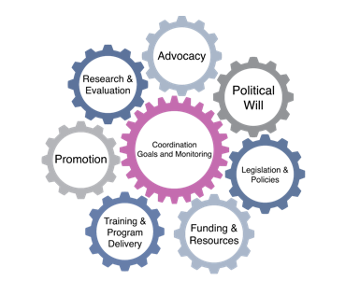
Becoming Breastfeeding Friendly (BBF)
Brief Development Guidance
Background + Introduction
Cara Safon, MPH | Research Associate
Grace Carroll, MPH, MA | Research Associate
1
Notes:
[Welcome + introductions]

Slide 2
Training Objectives
Background. Understand BBF brief development background
Part I. Learn how to write a BBF 1-pager
Part II. Learn how to develop a BBF infograph
Part III. Learn how to write a BBF policy brief
Part IV. Learn branding and design techniques for BBF briefs
Conclusion. Conclude BBF brief development training series
Notes:
The goals of this training series are to:
[CLICK] Understand the background on BBF brief development and reasons why we are conducting this training
[CLICK] Learn how to write a BBF 1-pager
[CLICK] Learn how to develop a BBF infograph
[CLICK] Learn how to write a BBF policy brief
[CLICK] Understand techniques for branding + designing BBF briefs
[CLICK] Summarize everything learned and conclude the series

Slide 3
Background. BBF Brief Development
1
Notes:
So, first, we are going to discuss why this training was developed by sharing the interactive, formative research process that the BBF-Yale team as well as its country partners – namely, Mexico and Ghana – engaged with in order to come up with guidelines for developing various types of briefs based on BBF policy recommendations, including the:
1-pager
Infograph
Policy brief
…as well as tips + tricks for how to format + design the layout for these various documents
These will serve as final products derived from various activities undertaken throughout the 5-meeting process

Slide 4
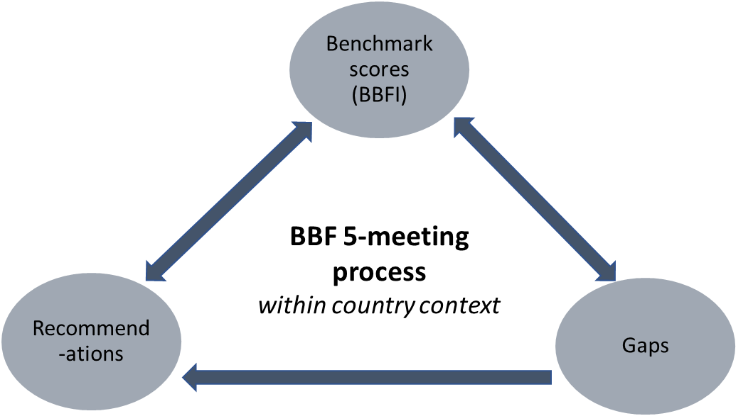
Developing + prioritizing BBF policy recommendations
Figure 1. Relationship between benchmark scores, gaps and recommendations
Notes:
Now, as you know, a critical aspect of BBF is identifying the gaps in your country’s breastfeeding programs and making robust, concrete recommendations to address these gaps. Experts in your country may know or have an idea about some of the gaps in the breastfeeding enabling environment in their area of expertise. These gaps may be confirmed or modified by the evidence-based benchmark scores. From the evidence-based scores and gaps, recommendations will be developed. The relationship between the benchmark scores, gaps and recommendations is a dynamic process that should be considered throughout the 5-meeting process (Figure 1).
Crafting meaningful recommendations that are understood by key stakeholders, such as policy and decision makers, media sources, funders, and other stakeholder organizations, is vital to translating these into actions. Well-designed recommendations can also be effectively monitored and evaluated, allowing a country to track its progress.
With meaningful recommendations developed throughout the 5-meeting process - with the help of the BBF briefs we will discuss in this training series - countries can develop strong briefs to be disseminated to policymakers and other decision makers down the road

Slide 5
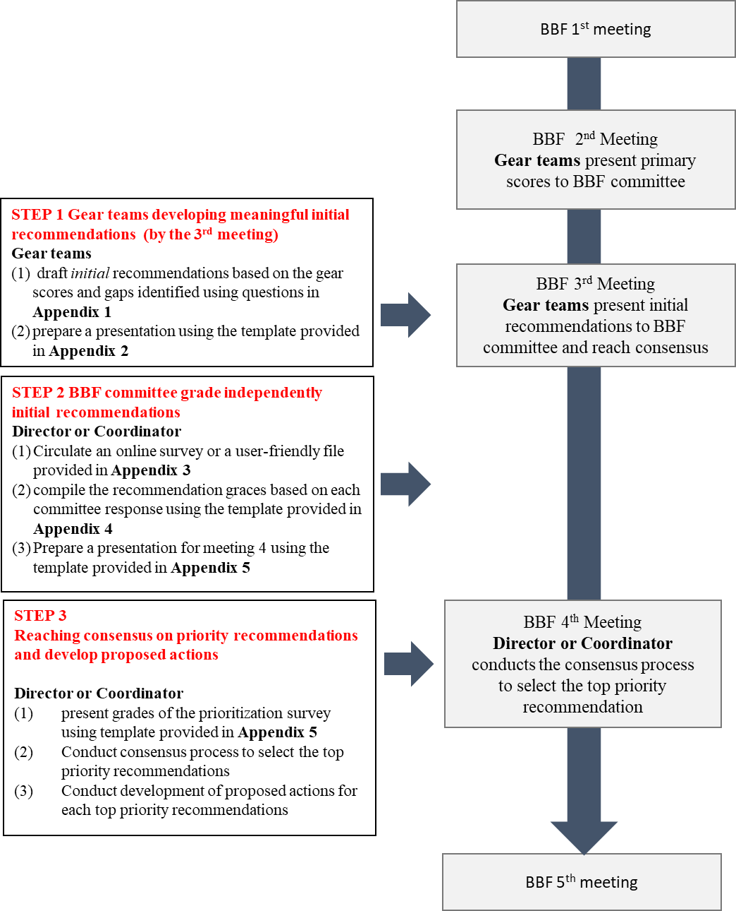
Figure 2. Steps of recommendation development and prioritization imbedded in the 5-meeting process
Notes:
In order to set the stage for the BBF policy development and prioritization process, we present a timeline describing each step. (Details can be found in the BBF Developing and Prioritizing Policy Recommendations methodology.)
The BBF recommendation development and prioritization process can be summarized in 3 steps (Figure 2) [CLICK] that can be executed throughout the BBF 5-meeting process
[READ ALL 3 STEPS IN RED + WHEN DURING BBF PROCESS THEY SHOULD TAKE PLACE]
Recommendation generation may be ongoing, alongside the scoring of benchmarks and identification of gaps. Notes on any proposed recommendation throughout the BBF 5-meeting process should be documented and can be considered by gear teams when developing recommendations
These steps should be undertaken in tandem with the development of BBF briefs

Slide 6
Key Aspects of Different Briefs
Type of brief | Length | Aim | Potential audience | When to prepare? | When to use?
Policy 1-pager | up to 2 pages | Engage stakeholders | Stakeholders | Between 1st and 2nd meeting | Throughout the 5-meeting process and beyond
Infograph | 1 page | Disseminate policy recommendations and summarize all policy evidence | Stakeholders; general public | Between 4th and 5th meetings | By 5th meeting and beyond
Policy brief | up to 4 pages | Disseminate prioritized recommendations | Policymakers, journalists, senior advisers to policymakers | Between 4th and 5th meetings | By 5th meeting and beyond
Adapted from: Wong SL, Green LA, Bazemore AW, Miller BF. How to write a health policy brief. Families, Systems, & Health. 2017 Mar;35(1):21. 7
Notes:
Now, there are many different types of briefs that communicate policy ideas. I will go through some of these examples here.
First, a policy 1-pager is aimed at engaging stakeholders; they can be prepared between the 1st and 2nd BBF meetings and used throughout the 5-meeting process and beyond; additionally, one or several can be prepared, depending on what is to be communicated to stakeholders
Second, an infograph of ~1 page is meant to provide easy-to-understand information for the audience to engage with simply, and is intended for stakeholders and the general public more broadly; they can be prepared between the 4th and 5th BBF meetings to be used by the 5th meeting – as well as beyond – in order to summarize all policy evidence; as many infographs as are needed may be prepared and used by BBF countries
Finally, a policy brief of up to 4 pages can be used to disseminate prioritized recommendations to a potential audience of policymakers and journalists; these should each focus on one recommendation, and can be prepared between the 4th and 5th meetings to be presented to policymakers and other decision makers by the 5th meeting and afterward
[Examples of a 1-pager and a 4-page policy brief can be found on the BBF website]

Slide 7
1-pager
Infograph
+ Policy Brief
Dissemination strategies
1st
Meeting
2nd
Meeting
3rd
Meeting
4th
Meeting
5th
Meeting
Suggested BBF brief development timeline
Notes:
Now that you understand the BBF policy recommendation development and prioritization process on a general level as well as the various types of briefs that can be utilized to communicate policy ideas within the BBF context, here you can see a timeline of recommended activities to complete during the BBF 5-meeting
These various documents – which we are calling briefs – will be outlined in the subsequent sections of this 5-presentation series on BBF brief development guidance
The next section of this training will focus on the policy 1-pager

