Slide 1


Older Adults, Cancer and Energetics
Wendy Demark-Wahnefried, PhD, RD
Professor and Webb chair of nutrition sciences
Associate director of cancer prevention & control
American Cancer Society Clinical Research Professor
University of alabama at birmingham

Slide 2
What is the median age of a cancer diagnosis?
66 years

Slide 3
Pros and Cons of Targeting Elders for Cancer Prevention and Control
Pros
Cons
Elders are at risk - 62% of cases 65+ - Population getting older - Data from chemical disasters suggest elders more prone - cell culture/cell passage show older cells more prone - increased cytokine production - age-related physiologic changes, ex. ↓ stomach acidity
Too Little- Too Late - mutations/machinery already set - adverse events outweigh benefits - significant barriers to interventions among the elderly
Notes:
Here are some reasons, some based on data and some based on speculation.
Cancer is a disease of the elderly…with the graying of the American populus this is going to be an even greater problem in years to come
Data from disasters, such as the dioxin spill in Seveso, Italy show that cancer rates are greater it the elderly than in other populations – supported by work in cell culture and that as age problems such as ….

Slide 4
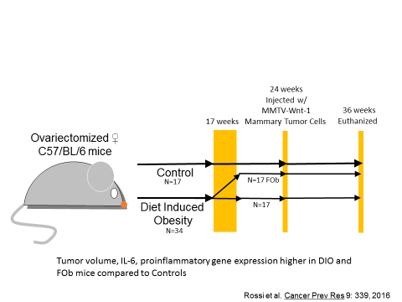
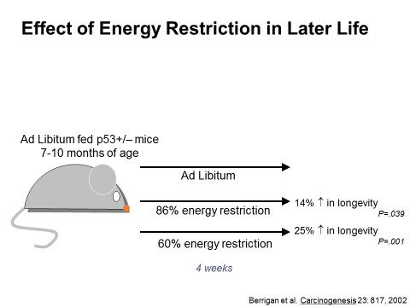
Studies in Animal Models in Later Life

Slide 5
% with Limitations:
Survivors vs. General Population
Hewitt, Rowland, Yancik. J Gerontol. 58:82, 2003
Notes:
National Health Interview Survey (1998-2000) 4,878 cancer survivors and 90,737 without hx of cancer. Risk of functional decline increases with each comorbid factor – here cancer survivors have about double the risk, but in the presence of one comorbid factor risk goes up fivefold,

Slide 6
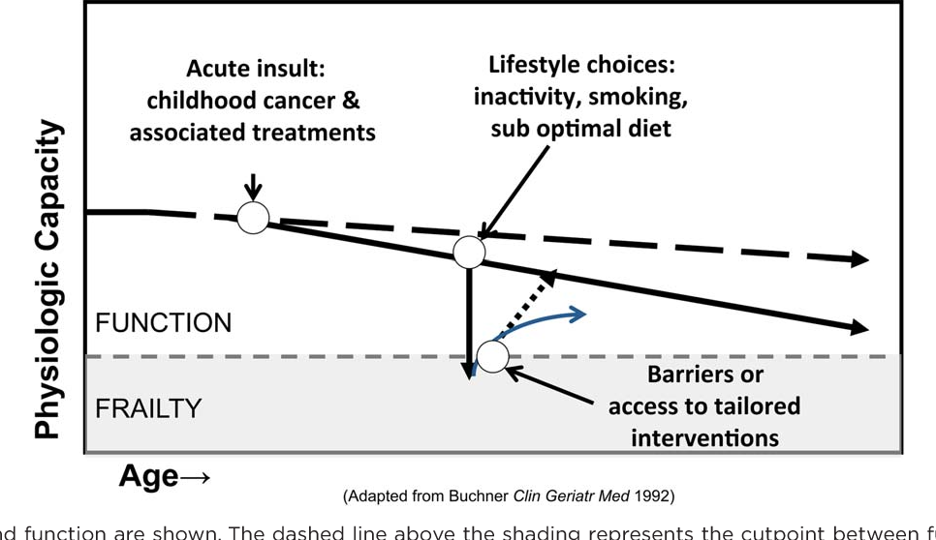
Frailty Prevention
Encourage lifestyles that maintain neuromuscular control, promotes muscle strength, and optimize energy metabolism
Cancer and associated treatment
Older Cancer Survivors
(especially females) frailty threatens function and ability to live independently
Frailty: Insufficient reserve to recover
Mercken EM et al. Of mice and men: the benefits of caloric restriction, exercise, and mimetics. Ageing Res Rev 2012;11:390.
Notes:
Frailty – Insufficient reserves to recover

Slide 7
Estimated associations between health behaviors & physical function (n=688)
Health Behavior | Point increase in SF36 Physical Function Subscale | P-value
Affirmative response to vigorous exercise 20 min at least 3 x weekly | 15.4 | P<.0001
One daily serving increase in F&V | 0.9 | P=.0049
1% decrease in total energy from fat | 0.2 | P<.0001
Demark-Wahnefried et al. Intl J Behav Nutr Phys Act 1:16, 2004 (www.ijbnpa.org/content/1/1/16).

Slide 8
AICR/WCRF Lifestyle Recommendations
Be a healthy weight (avoid weight gain in adult life)
Be physically active
Eat a diet rich in whole grains, vegetables, fruits and beans
Limit consumption of “fast foods” and other processed foods high in fat, starches or sugars
Limit consumption of red and processed meat (12-18 oz/week)
Limit consumption of sugar-sweetened drinks
Limit alcohol consumption
Do not use supplements to cancer prevention
Up to 71% Older Cancer Survivors Overweight/Obese
53-70% Older Cancer Survivors Insufficiently Active
52-85% Older Cancer Survivors Suboptimal Diets

Slide 9

Additional Justification for Lifestyle Interventions in Older Cancer Survivors
11.1% of older adults (n = 15,425) adhere to US guidelines for alcohol, tobacco, dietary fat and fruits & vegetables (F&V), and exercise. Most common lifestyle pattern among elderly is adherence to alcohol & tobacco guidelines, but not those for F&V, dietary fat, and exercise. Berrigan et al. Prev Med 36:615,2003
In 753 older breast, prostate & CRC survivors, diet quality associated with ↑Physical QoL & higher BMI associated with ↓ QoL Mosher et al. Cancer. 115:4001, 2009.
Older female survivors (n=2,017) who practice 6-8 vs 0-4 WCRF/
AICR Recommendations have 33% lower all cause mortality
Inoue-Choi et al. CEBP 22:792, 2013
Notes:
It must be noted that although the elderly, of any age group has the highest proportion of individuals who adher to national guidelines for various lifestyle factors, this segment of adherers only consistitues 11.1% of the elderly population. Life all other age groups, the most common lifestyle pattern among the elderly is adherance to tobacco and alcohol guidleines, but non-adherance to guidelines for exercise, dietary fat and fruit and vegetable consumption. We need to see how interventions that target multiple behaviors work, especially given a host of studies which show that by intervening in one area, you can bring other behaviors along with it….case in point are physical activity interventions of Bess Marcus which show that smoking cessation programs that include physical activity components are more effective than unidimensional programs

Slide 10
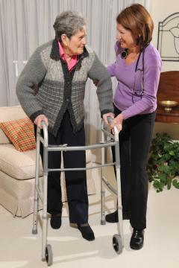
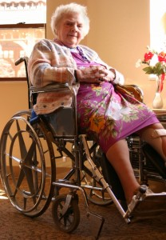
Frailty of a
different
Phenotype
In 261 older Breast Cancer Patients, odds of frailty with obesity are increased 1.12 (95% CI: 1.01;1.19) p=.003 Bennett et al. Oncol Nurs Forum 40:E126, 2013
In 280 older Prostate Cancer Patients, odds of falls in the past year 2.97 (95% CI: 1.62-5.58) in obese vs. 2.15 (95% CI: 1.18-3.94) in non-obese Winters-Stone et al. J Am Geriatr Soc 65:1414-19, 2017

Slide 11
Effect of Weight Change on Physical Function in Women Age 65+
Fine et al. JAMA. 282:2136, 1999

Slide 12

Adherence to
Weight Management
Adults
Up to 2 Pounds/week
500-1000 kcal/day deficit
versus
Older Adults
Concerns:
Sarcopenia
Functional Decline
Approach:
1) Energy Restriction
500-750 kcal/day deficit= results in up to 1.5 lbs w⁻¹
2) Resistance Training
NHLBI 2013,
2013 AHA/ACC/TOS,
ACS 2012
Villareal DT, NAASO,
Obes Res 2005;13:1849

Slide 13
Considerations in Delivering Diet and Physical Activity Programs to Older Cancer Survivors
Challenges | Solutions
Transportation Issues | Distance-Medicine Based Approaches
Unaware of Increased Risk | Need to Increase Awareness
Lower Health Literacy | Appropriate Reading Level
Functional/Sensory Deficits | Large font, screen size, buttons, & keyboards; volume control; brief modules, cognitive/ computer pre-training and/or provision
Value Preferences for Immediate Gratification | Incremental Goals with ample reinforcement
Caregivers | Dyadic Approaches
Preference for Holistic Programs that have Meaning & Involve Others | Need for High Engagement
Increased cumulative disease burden | Tailor to extant health conditions
Courneya et al. Crit Rev Oncol/Hematol 51: 249, 2004; Rao & Demark-Wahnefried Crit Rev Oncol Hematol 60:131, 2006; Klepin Interdisc Topics Gerontol. 2013;38:146-157.
Notes:
It also must be recognized that elderly bring their own sets of barriers to interventions, and that these must be overcome if the intervention is to be optimally effective. For example, common beliefs may need to be challenged since the elderly are more likely to view cancer as a death sentence that they’re powerless to stop….they also tend to be unaware that they’re at increased risk. Finally, there may be issues with literacy and other barriers. Distance, especially can be a barrier to elders who may no longer drive.
These are issues regarding the patient, for interventions that are channeled through the health care system we also have to be concerned about the provider

Slide 14
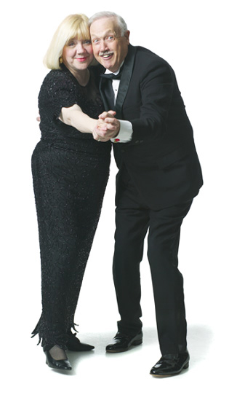
RENEW (R01-CA106919)
(Reach-out to ENhancE Wellness in Older Survivors)
N=640
Long-term Survivors of Breast, Prostate & Colorectal Cancers
Promoted Weight Loss 0.5 kg w⁻¹ Calorie budget (logs), portion control, & volumetrics
Healthful Diet ACS Guidelines
Resistance Training 3x w⁻¹ Aerobic Exercise 150 minutes w⁻¹
11M Intervention Period – 2 year long-term follow-up
Tailored Workbook and 5 Tailored Mailings
15 Telephone Counseling Sessions
8 Telephone Prompts

Slide 15



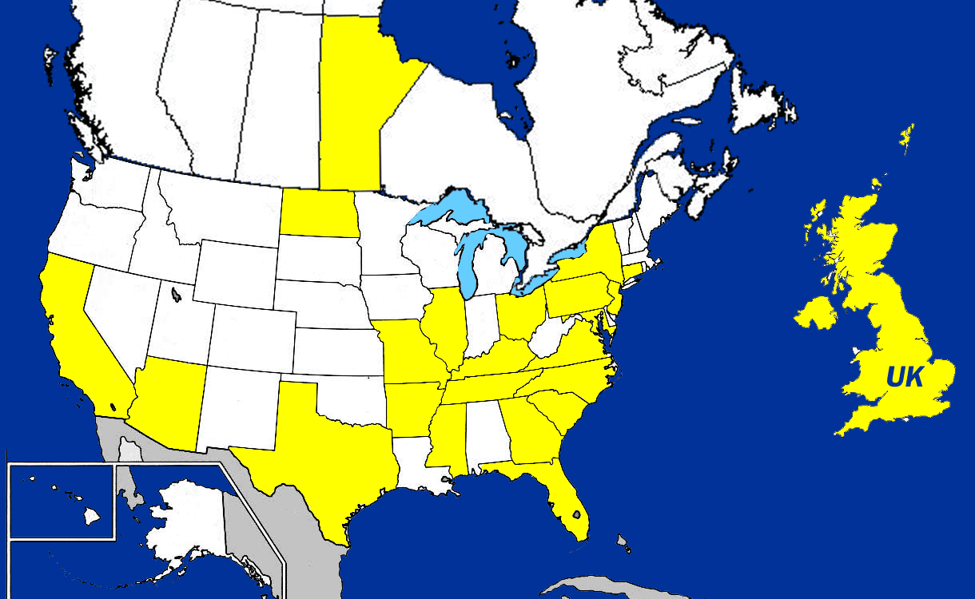

Slide 16

Study Schema
Recruited Survivors through Self-Referral and Cancer Registries
641 Survivors
319 Intervention
321 Observation
24% attrition
over 2 years
269 Observation
289 Intervention
243 Follow-up (2y)
245 Follow-up (2y)
intent to treat analysis

Slide 17
RENEW Study Sample Characteristics (n=641)
Age | 73.1 (5.1) (range 65-87)
% Male | 45%
% Caucasian | 89%
Education | 33% < HS 30% Some College 37% > College Grad
Type of Cancer | 45% Breast 41% Prostate 14% Colorectal
% Cancer Registry | 92%
Years since Dx | 8.6 (2.7) (range 5-26)
# of Comorbidities | 2 (1.2)
Current Smoker | 6%
Physical Function (SF 36) | 75.7 (18.9) (range10-100)

Slide 18
Results
 | Intervention Arm Mean (SE) | Δ Wait List Control Arm Mean (SE) | P- value
SF-36 Physical Function | -2.55 (1.07) | -5.39 (1.01) | .034
Basic Lower Extremity – LLF | +0.41 (0.71) | -2.11 (0.67) | .005
Adv. Lower Extremity – LLF | +0.44 (0.60) | -2.55 (0.61) | .015
Strength Exercise (min/w) | +22.2 (2.8) | +0.5 (3.0) | <.0001
Strength Exercise (session/w) | +1.4 (2.6) | +0.2 (2.5) | <.0001
Endurance Exercise (min/w) | +43.1 (5.7) | +26.1 (6.3) | <.0001
Endur. Exercise (session/w) | +1.6 (3.9) | +0.5 (4.1) | .005
F&V Intake (servings/d) | +1.48 (0.16) | +0.15 (0.12) | <.0001
Saturated Fat Intake (g/d) | -3.64 (0.61) | -1.19 (0.55) | .002
Healthy Eating Index | +7.1 (0.9) | +1.4 (0.8) | <.0001
Weight (kg) | -2.45 (0.22) | -1.03 (0.2) | <.0001
BMI | -0.82 (0.07) | -0.035 (0.08) | .0002
Quality-of-Life (Total SF-36) | +0.91 (0.86) | -2.17 (0.90) | .025
Morey M et al. JAMA 301: 1883-91, 2009

Slide 19
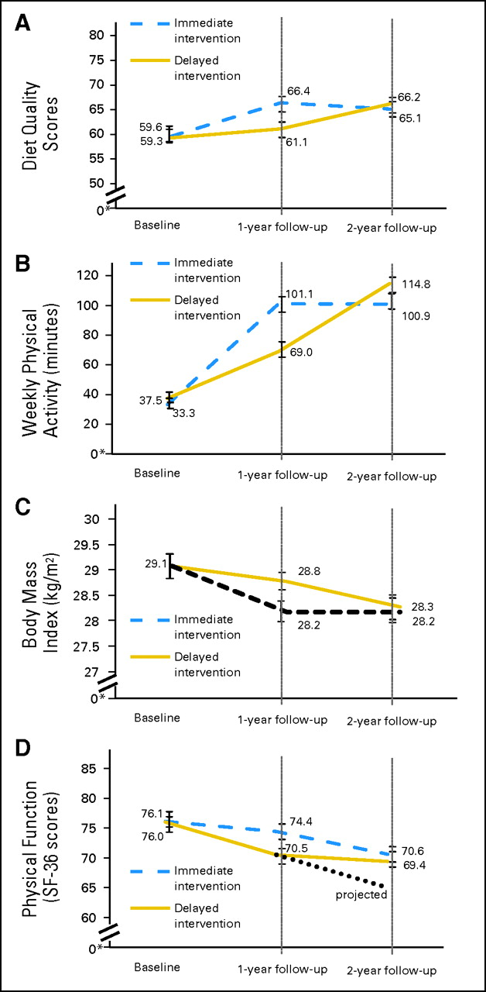
dietary quality
physical activity
(C) BMI
(D) physical functioning
Baseline to 2-year
changes in the
immediate- vs.
delayed intervention
arms
©2012 by American Society of Clinical Oncology
Demark-Wahnefried et al. JCO 30:2354-61,2012
Notes:
Change in (A) dietary intake and quality, (B) physical activity, (C) body mass index (BMI), and (D) physical functioning in response to the Reach Out to Enhance Wellness intervention in the immediate- versus delayed-intervention arms over 2 years. (*) Scales are truncated to show typical ranges or, in the case of BMI, a range characteristic of borderline overweight/obese populations. SF-36, Short Form-36.

Slide 20
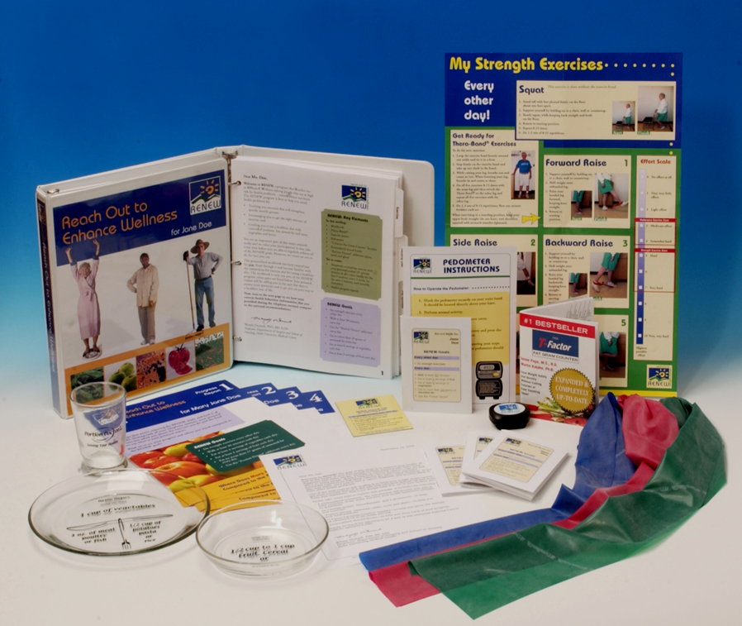



RENEW (n=641) Breast, Prostate & Colorectal CA Survivors
(R01 CA81191)
Survivorshine
(ACS CRP-14-111-01CPPB)
AMPLIFI (n=652) Survivors of 6 Obesity-related CAs focusing on older, minority and rural (P01 CA22997)
Understanding of combined effects of caloric restriction and exercise (aerobic & resistance) on physical function
Understanding of ordering of caloric restriction and exercise (aerobic, resistance & balance)
Impact on physical function & performance
Impact on muscle mass D3 creatine and biomarkers

Slide 21
Conclusions
There are several considerations in delivering programs to older cancer survivors
Programs must address the health risks in these populations: e.g., frailty, sarcopenia
Programs also need to overcome well-known barriers: distance, literacy, functional deficits, and address preferences to optimally engage.

Slide 22
Acknowledgements
RENEW
Elizabeth Clipp, PhD
Harvey J. Cohen, MD
Miriam Morey, PhD
Bercedis Peterson, PhD
Richard Sloane, MPH
Denise Snyder, MS, RD
AMPLIFI
Kevin Fontaine, PhD
Kelly Kenzik, PhD
Robert Oster, PhD
Dorothy Pekmezi, PhD
Maria Pisu, PhD
Laura Rogers, MD, MPH
YuMei Schoenberger-Godwin, PhD
Michelle Martin, PhD (UTHSC)
R21 CA161263
R21 CA178359
Thanks to All of the Cancer Survivors who Participated in this Research
Funding: ACS, R01CA148791, R01 CA81191, R01CA106919, R21CA161263 R21 CA178359, P01CA22997

